Slide 1
Data Of Used Cars
About The Project:
This program is a batch processing solution designed to automate the data cleaning and The program processes large datasets and performing comprehensive data cleansing operations to eliminate errors ,inconsistencies, and duplicates. After cleaning, the data is transformed into the appropriate format for efficient storage and querying. The final step involves securely inserting the processed data into a cloud data warehouse ensuring that it is ready for analysis, reporting, and business intelligence applications.
Built With:
Our program is developed using the most efficient programming languages, robust libraries, and top-tier database management tools to enhance performance and optimize storage solutions.
Languages:
Python
MySQL
Cloud storage:
Amazon aws s3
Amazon aws Redshift

Slide 2


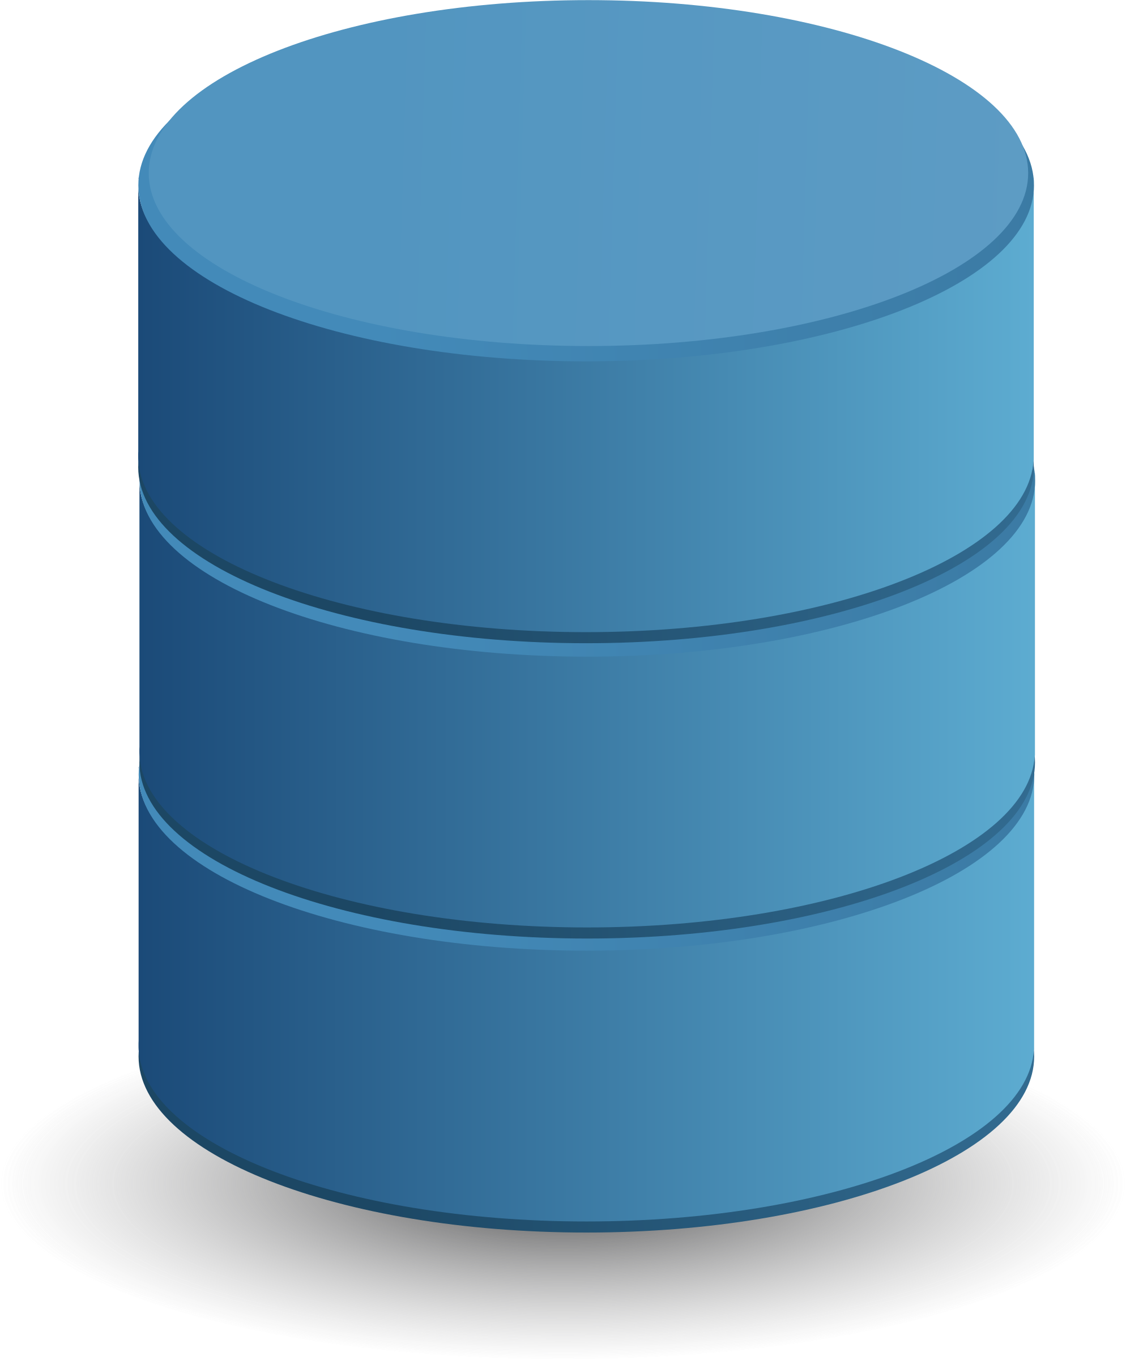




Architecture Of Program
Extract
Transform
Load
Export
Source
Pandas
MySQL
File System
Source File
Data Cleaning &
Data Forming
Structured Data Inserting Into MySQL
Exporting Data To Filesystem
Load
Copy
Upload
AWS REDSHIFT
Python
AWS S3
Data Successfully Loaded Into Table
Using Copy Command Inserting the Data Into Table Via Python Script
Uploading Exported Data Files Into S3

